Slide 1

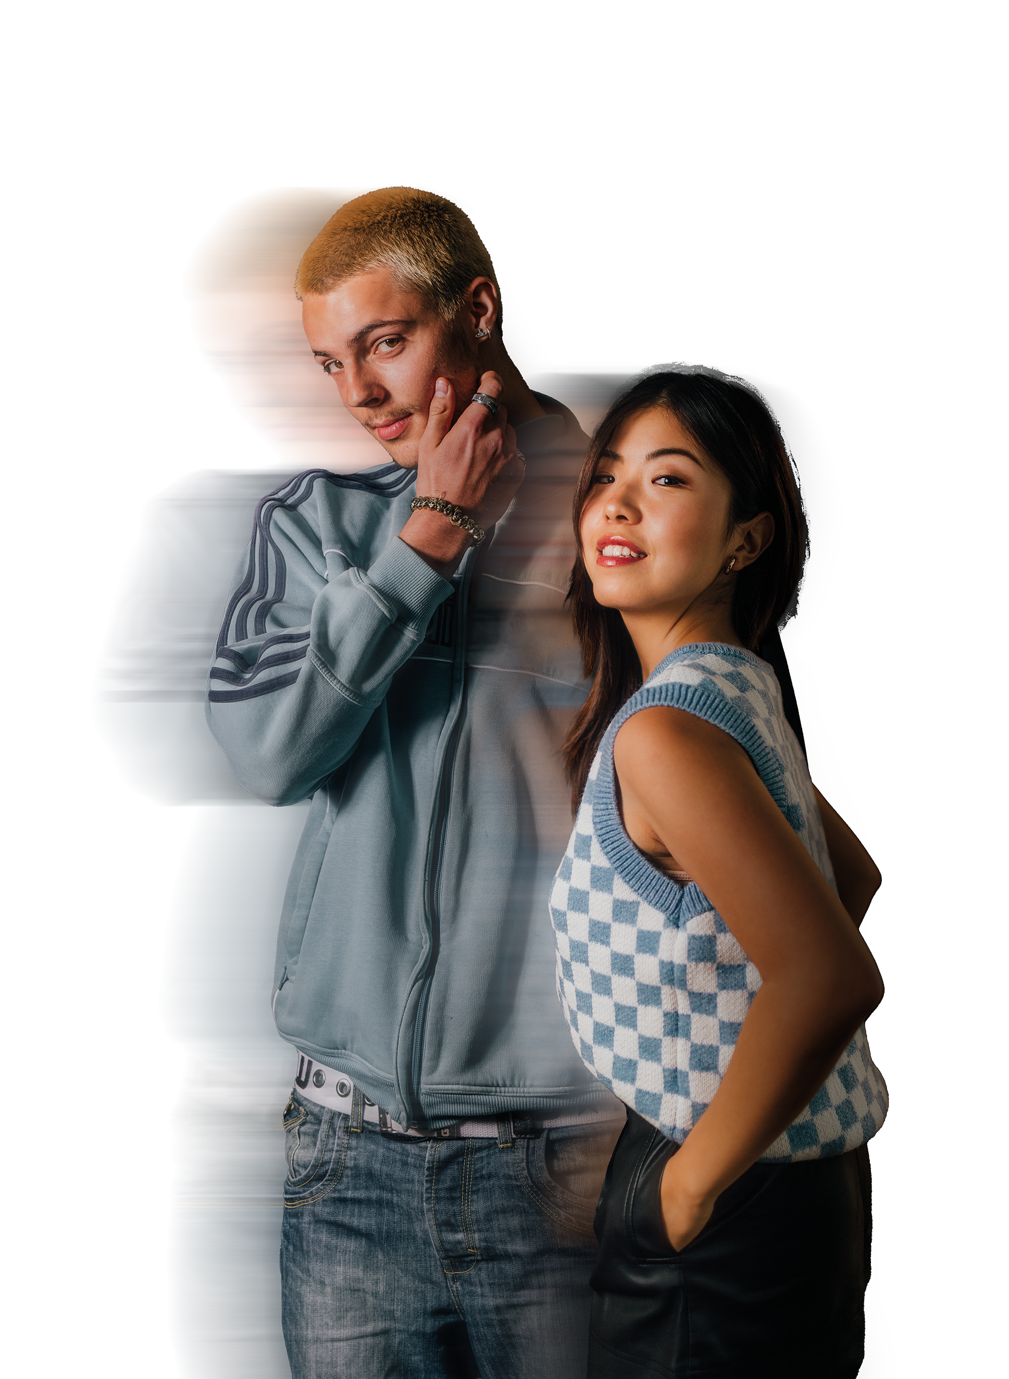
MERCHANDISING
FOR FASHION
HOME OF FASHIONS NEXT GENERATION

Slide 2
WHAT IS MERCHANDISING?
“Ensure that products appear in the right store - or on a website - at the right time and in the right quantities.”​

Slide 3





WHAT INFLUENCES A MERCHANDISER?
PAST
PERFORMANCE​
Looking back at the past performance of the same or similar garments. ​
WEATHER​
What do weather patterns over previous years tell us about what’s to come?
FASHION TRENDS​
What new trends are coming through?
COST​
How much is it going to cost to manufacture and distribute? Is that commercially
viable?​
DATA​
In particular sales data to inform decision-making. But beware: What sold well before may not sell well again!​

Slide 4
ACTIVITY
Imagine it is the end of the summer season, the shop is moving to their autumn items. Your activity is to review the table on the next slide and consider your items you will put on sale. Think about:​
​
How well are the items selling?​
What items work well all year round?​
What would you stock more of?​
What would you discount?

Slide 5
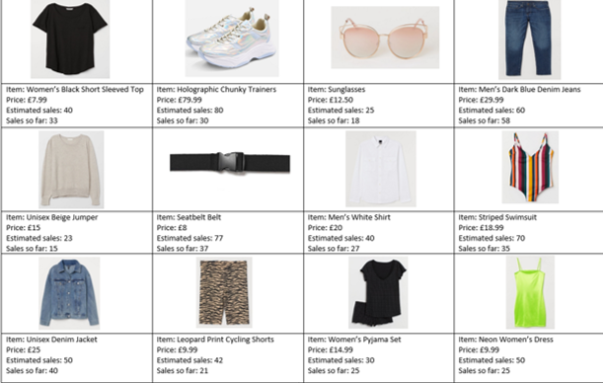

Slide 6
RECAP
Merchandisers play a key role in the commercial success of a fashion retailer​
They need to analyse data of previous sales, consider trends and study other evidence sources to inform their decisions​
Influences are often out of their control but they work with this to make experienced judgements​

