Slide 1
Summer preparation
L3 fashion design

Slide 2
WGSN/ Pinterest
Look at these sites and produce some trend boards based on the information they are predicting, trends can be floral, leather, lace, sportswear lux, minimalism, a colour, collars, sleeves, oversized, military, no need to print just keep them as reference, think about layout no need to overload the page
This Photo by Unknown Author is licensed under CC BY-SA

Slide 3
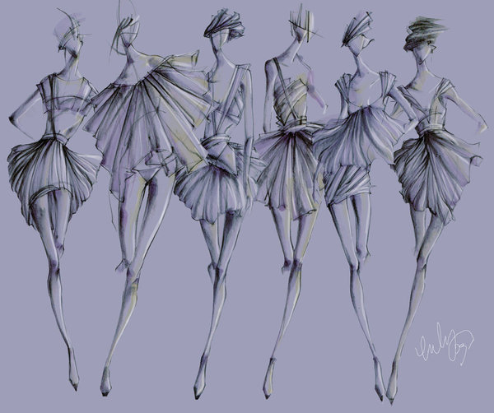
Draw
Draw every day, does not have to be fashion specific but just develop your line drawing and no need to add colour, this can be life drawing of family members, still life around the house or garden, any view from a window.
If you have magazines at home start doing some fashion illustrations, draw the figure and think about proportion, 3 heads depth to the waist, elbow to hit waist point and wrist to hit hip point, elongate the legs for illustration purposes
Bring your work together and review and reflect on it, try curating it.

Slide 4
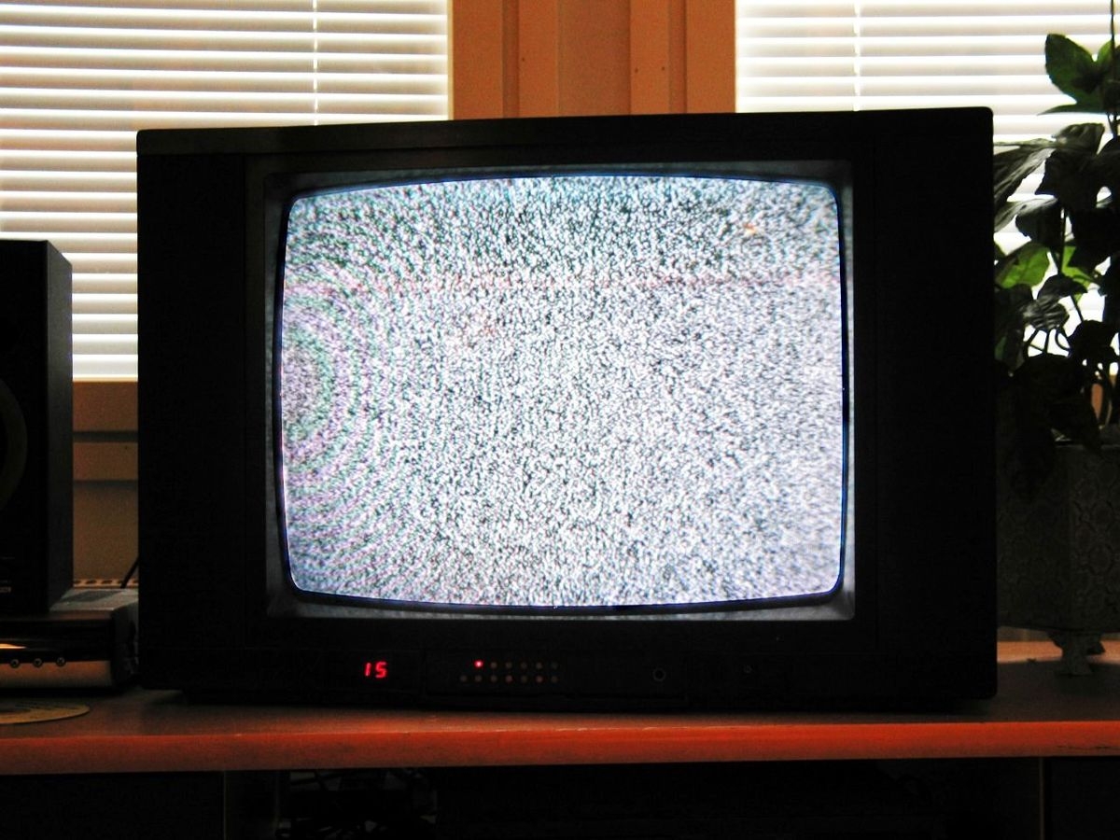
Watch
Netflix and other channels:
Watch McQueen, The Sept issue, DRIES, Jeremy Scott the people’s designer, The fashion fund, these will all give you a sense of the design process and how things work.
Does this influence your opinion of the design world?
Does it give you insight to the type of fashion roles you would like?
This Photo by Unknown Author is licensed under CC BY-SA

